Slide 1


“Hunger Marketing and Blockchain Technology: Applications in Wireless Spectrum Management”
“Hunger 마케팅과 블록체인을 이용한 무선 스펙트럼 관리 기술”
Njoku Judith Nkechinyere Manuel Eugenio Morocho Cayamcela Wansu Lim
Department of Electronic Engineering Department of Electronic Engineering Department of IT Convergence
Kumoh National Institute of Technology (KIT)
Daehak-ro 61, Gumi, Gyeongsangbuk-do, South Korea
[e-mail: {judithnjoku24, eugeniomorocho, wansu.lim}@kumoh.ac.kr]
This work was supported by the National Research Foundation of Korea(NRF) grant (No. 2017R1C1B5016837), the ITRC Program (IITP-2019-2014-1-00639), and by Kumoh National Institute of Technology (2019-104-155).

Slide 2
General Overview
Motivation
Challenges
Proposed Solutions
Conclusions and Future Work

Slide 3
Motivation
There is a continuous development of modern communication.
An ever increasing demand for bandwidth by mobile application users
And ever growing new applications in wireless communication.
In 1990, there were about 12 million mobile subscriptions worldwide with no data services. By 2015, the total number of mobile subscriptions exceeded 7.6 billion with the amount of data on networks reaching 1,5777 Exabytes per month by the end 2015.

Slide 4
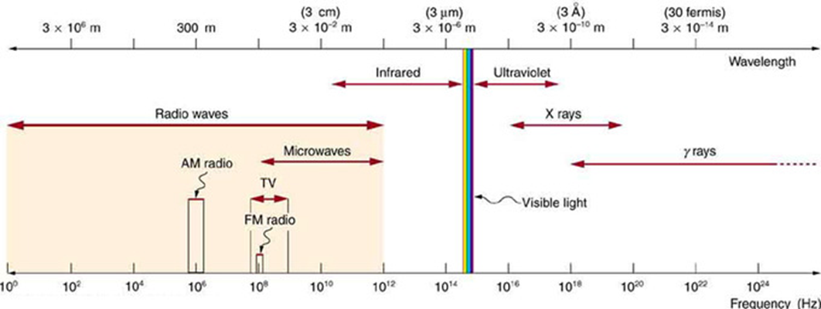
Challenges
Only a limited section of the electro-magnetic spectrum supports radio communication 3kHz to 300GHz.
User demand for spectrum remains unpredictable and stochastic
There is a need to use this treasured resource in a productive way
SPECTRUM MANAGEMENT

Slide 5
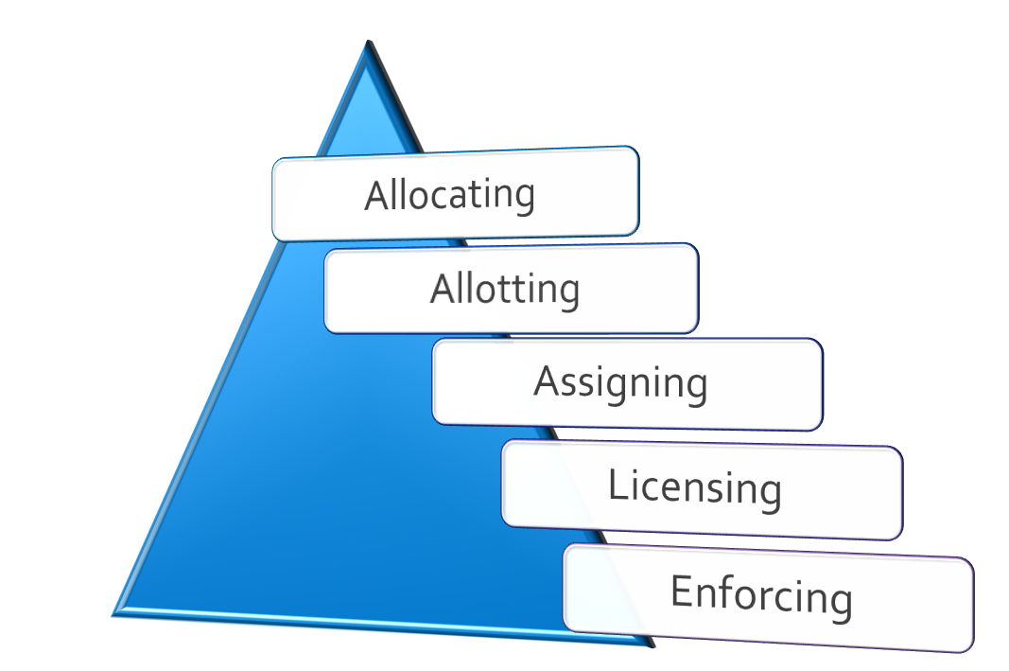
Spectrum Management
It refers to all activities essential to regulating the use of the radio spectrum.
Greater capacity can be delivered by the same amount of spectrum, once a more efficient technology is applied.

Slide 6
Proposed Solutions
Spectrum management mechanisms have evolved to meet the different requirements of increasing spectrum use efficiency.
In this paper, we review two state of the art approaches for spectrum management
Hunger Marketing
Blockchain Technology

Slide 7
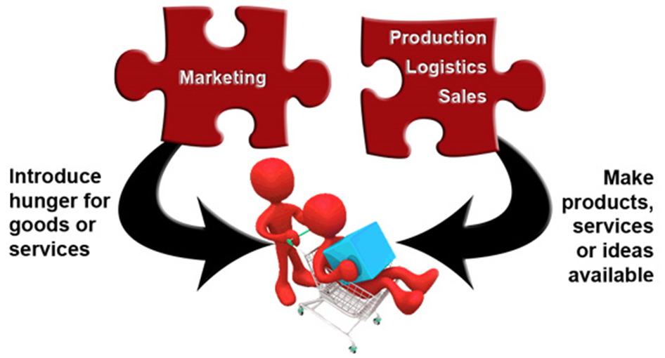
Proposed Solutions
Hunger Marketing
This is a psychological marketing strategy in which the service provider actively limits consumer supply in order to achieve the trend of excess demand.
This technique relies on human emotions, making them hunger for things that other people want.
Addresses User’s stochastic demand

Slide 8
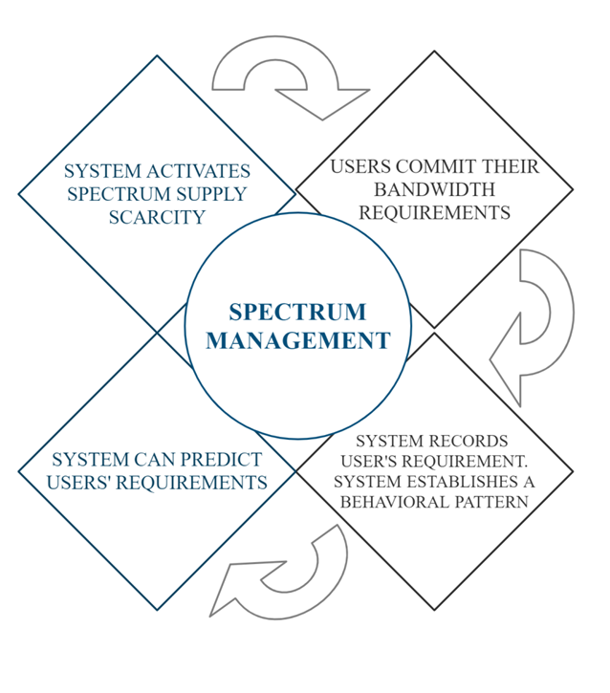
Proposed Solutions
Hunger Marketing in Spectrum Management
The system maintains a certain spectrum supply shortage when implementing hunger marketing, thus stimulating user’s ability to schedule and commit their bandwidth requirements in advance.
Feng Li Et al consider a multi-beam satellite system which stays in geostationary tracks and adopts spectrum reuse techniques to enhance spectrum efficiency.
Implemented in a scenario where users need to purchase bands from satellite systems

Slide 9
Proposed Solutions
Hunger Marketing in Spectrum Management
The major aim while formulating the spectrum management of the satellite is to
Analyze every cost of satellite systems
and achieve an optimal spectral level in the spectrum pool on the basis of the satellites user’s stochastic demand.

Slide 10
Proposed Solutions
Benefits of Hunger Marketing in Spectrum Management
There will be an increased predictability of user’s behavior
Improved spectrum management.

Slide 11
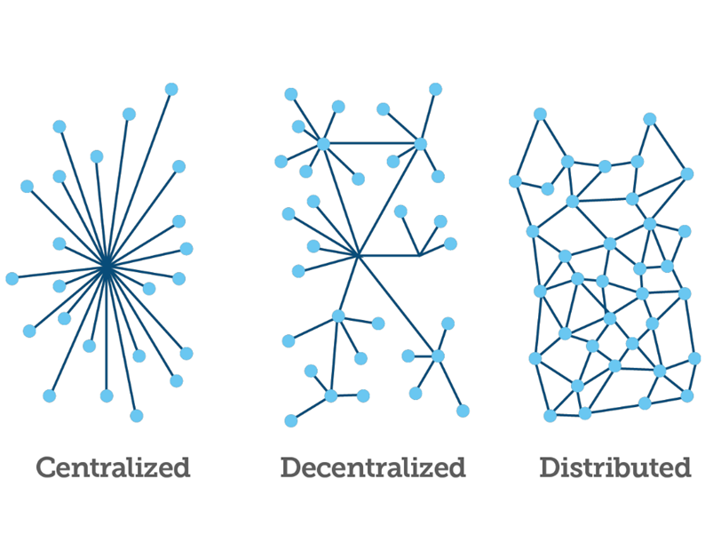

Proposed Solutions
Blockchains
Blockchains are distributed databases that can be securely and iteratively updated
The concept has been in use since early 1990’s and has only recently been developed to enable secure, private financial transactions for instance Bitcoin.
Allows for the transfer of money between different entities on a network without need for a central authority to verify the transaction
Distributed databases offer tracking property rights and assets

Slide 12
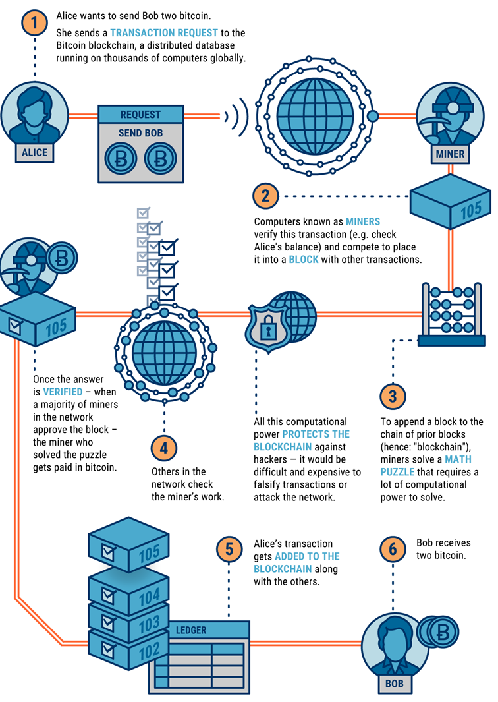
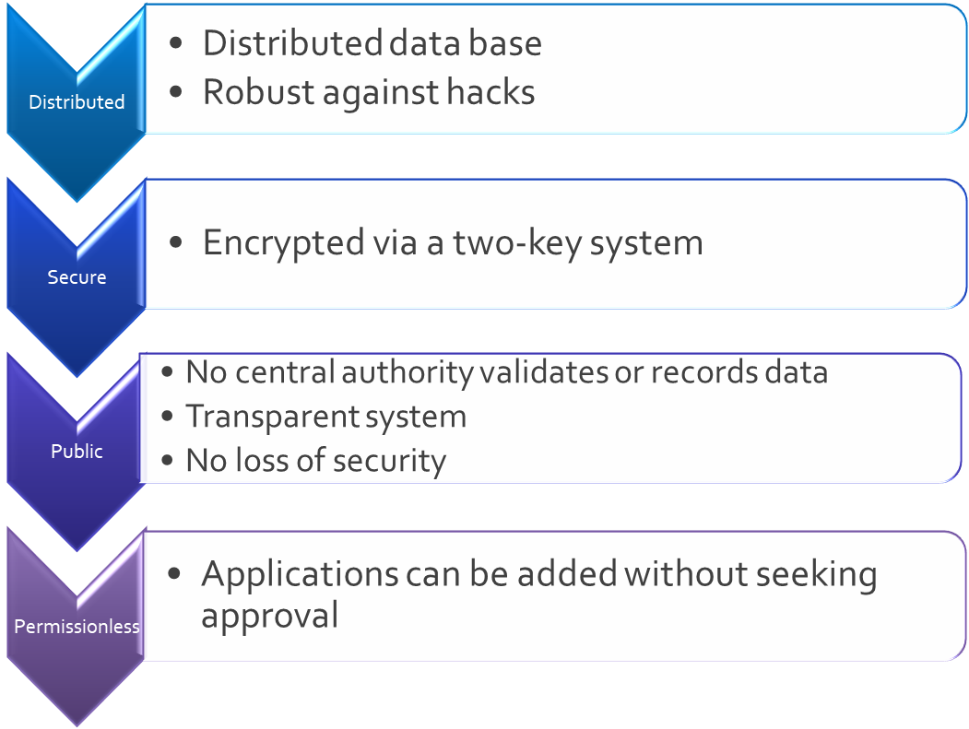
Proposed Solutions
How do Blockchains work?

Slide 13
Proposed Solutions
Blockchains in Spectrum Management
Khashayar, et. al proposed the use of blockchain technology to improve the medium access protocol and security of cognitive radios (CRs) desiring access to unused licensed spectrum .
They take advantage of the open-source nature of blockchain to propose a secure distributed medium access protocol for CRs to lease and access available wireless channels
In their scheme, every spectrum lease transaction is verified and cleared, then stored within a block. The new block then gets linked to the previous block, thereby forming a chain. Each block records the transactions of thousands of users in a way that records cannot be altered by a malicious user or users.

Slide 14
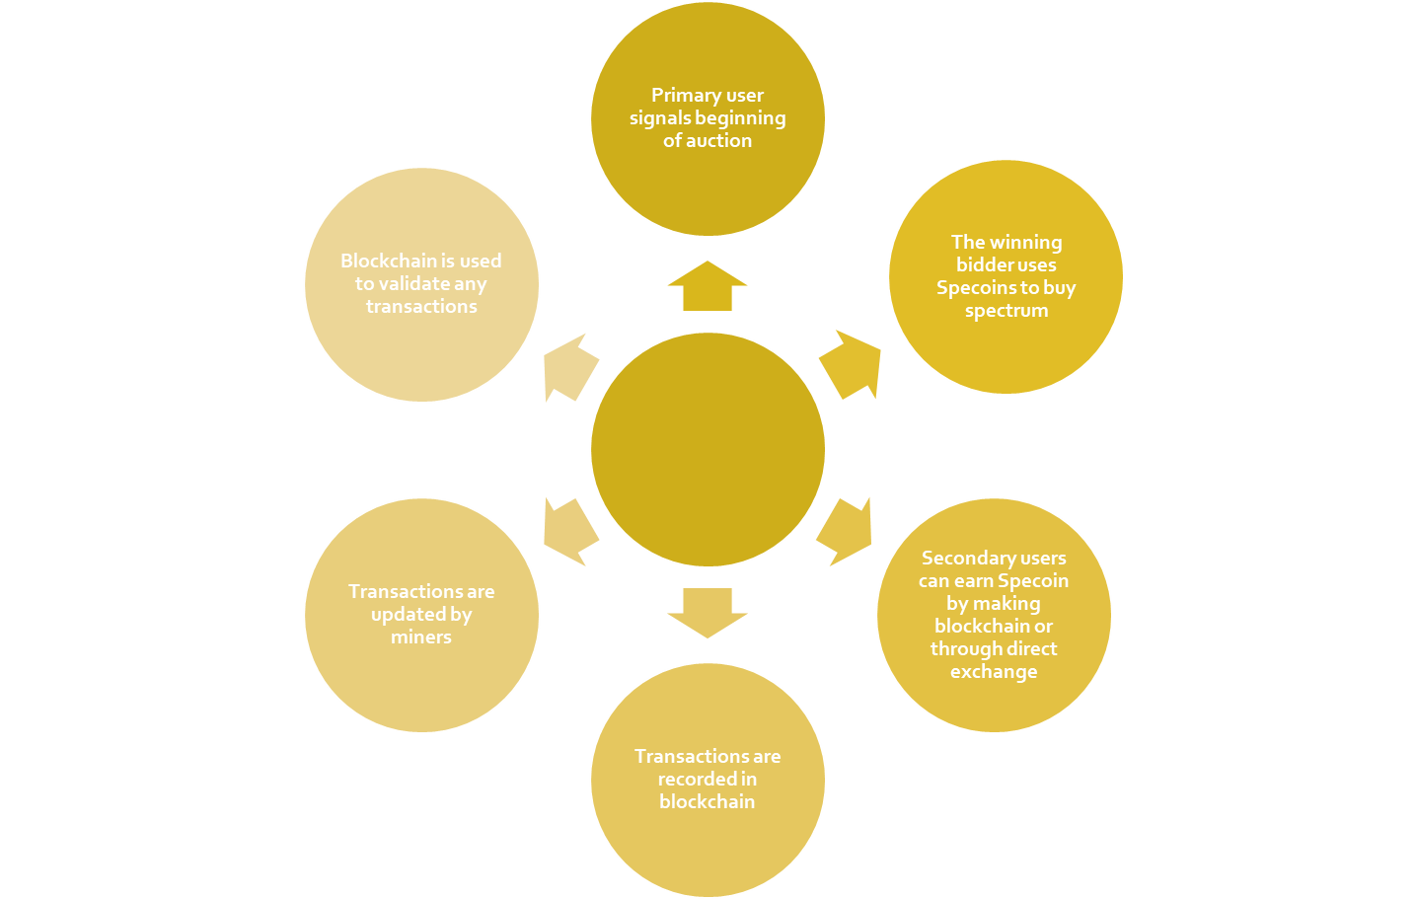


Proposed Solutions
Blockchains in Spectrum Management

Slide 15
Proposed Solutions
Benefits of Blockchain Technology in Spectrum Management
Increased speed in assessing usable spectrum in each area
Registering spectrum use without processing delay of a regulator’s authorization
The information in the distributed ledger can be used by regulators to:
Evaluate spectrum access performance
Measure spectrum usage fees
Implement spectrum access regimes

Slide 16
Proposed Solutions
Limitations of Blockchain Technology in Spectrum Management
Tendency of errors: Since a blockchain is used as a database, it is important that the information it receives is of impeccable quality as like all centralized databases, a blockchain system of records operates in a ‘garbage in’, ‘garbage out’ fashion.
The 51% attack: Suppose more than half of the computers working as nodes in a blockchain network validate something, it is considered to be true. In the same vein, if half of the nodes tell a lie, then the lie will be considered as the truth by the entire blockchain

Slide 17
Conclusion and Future Work
Spectrum management is a compelling research area and it is already very essential today.
In this paper, we investigated two novel techniques for spectrum management: Hunger management and Blockchain technology.
For future research, we believe that a disruptive technology as blockchain can benefit from Artificial intelligence’s ability to accelerate the analysis of enormous amount of data.
Predictive Machine learning models based on the blockchain technology.

Slide 18
Q&A Thank You

